Slide 1
ECS7012U/P Music and Audio Programming

Slide 2
Music and Audio Programming
Class
Thursdays, 9-11
Room Eng:B9 – IoC LT
Lecturer
Prof. Josh Reiss, joshua.reiss@qmul.ac.uk
Room 4.07, Engineering building (its almost impossible to find)
Labs – tentative, check your calendar!
Mondays, 11-1
Room Eng. 3.56
Website
Course notes
Assignments
News, messages…
See QMPlus
qmplus.qmul.ac.uk/course/view.php?id=15537

Slide 3

Lab assignments
Lab assistant: Angeliki Mourgela
a.mourgela@qmul.ac.uk
Unmarked assignment: Audio effect analysis
Get JUCE, VST, Visual Studio up and running
Edit existing code, build simple plug-in
Unmarked
Assignment 2: Audio effect programming
Modify and program an example audio effect
Show that your code works correctly as a VST plug-in
Due: Early March
Assignment 3: Original audio effect
Create and investigate your own audio effect
Use programming environment of your choice
Results to be presented in class
Due: Late March
Assignment 0 (unmarked): Hello World
Get Juce up and running
Work through tutorial, build simple plugin
Assignment 1 (20%): Karplus-Strong algorithm
Work through tutorial, build simple instrument
Analyse system, show it works
Due: Late February
Assignment 2 (30%): Multiband compressor
Modify and program an example audio effect, e.g. multiband compressor
Show that your code works correctly as a VST plug-in
Due: Late March
Assignment 3 (50%): Original audio programming
Create and investigate your own audio system
Results to be presented in class
Due: Early April
Lab Demonstrator
Nelly Garcia
n.v.a.garcia-sihuay@
qmul.ac.uk

Slide 4
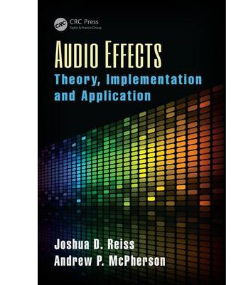
Primary text
Audio Effects:
Theory, Implementation and Application
Original text by J. Reiss and A. McPherson
Content to be posted on QMPlus each week
Includes
source code
audio samples
sample problems

Slide 5
Want a good grade?
Attend the lectures
I might give hints
Study lecture notes
Primary source
Study the text
I’ll tell you which sections are relevant
Work through any problems I suggest
I’ll provide study guides
Browse additional materials
DAFx book
Julius Smith’s online publications
ccrma.stanford.edu/~jos/pubs.html

Slide 6
What you need to know
Signal representation
Basics of discrete time
Reading/writing audio files
Digital Systems
Impulse Response
Transfer functions
Frequency Response
IIR /FIR Filters
Visualisation
Signal Flow Graphs
Block Diagrams
Spectral Analysis
FFT
Windowing
Visualisation
Power Spectrum
Spectrogram
Time-Frequency Representation
Pseudo-Code
C/C++
Know the basics, but we will revisit much of this

Slide 7
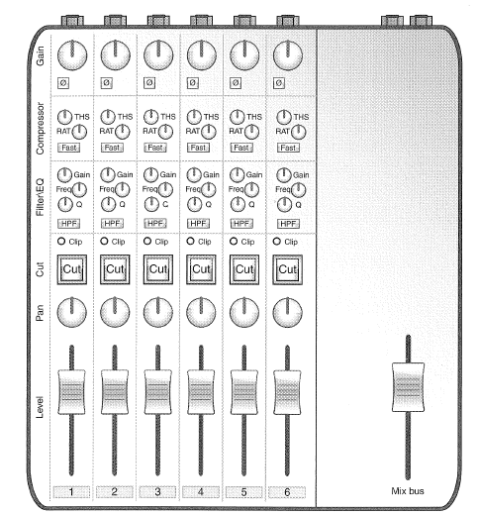
Module outline (1/2)
Introduction
JUCE
VST
Hello Worlds
MIDI
MIDI Hello World
Using a keyboard
Building a synth
MIDI effects
Delay-based effects
Echo
Comb filtering
Flanging, chorus

Slide 8
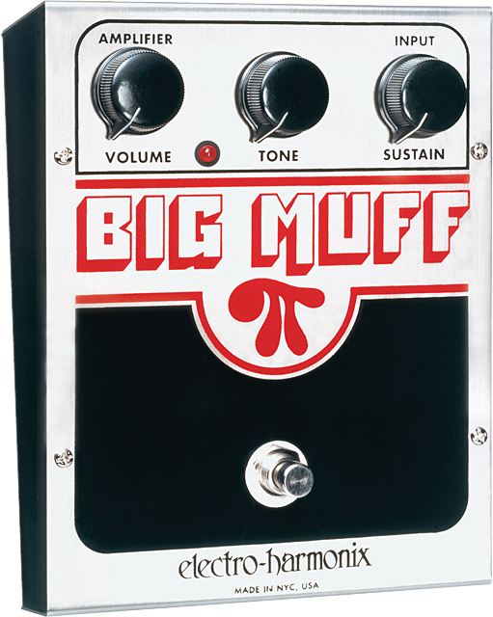
Module outline (2/2)
Filter effects
Graphic and parametric equalisation
Wah-wah, Phasers
Modulation
FM Synthesis
Tremolo
Ring modulation
Overdrive, distortion & fuzz
Dynamics processing
Compression, expansion
Limiting, de-essing
Phase vocoder
Pitch shifting; robotisation, whisperisation
Spatial audio
Reverb
Final assignment presentations

Slide 9

Sound Effects and Audio Effects
Sometimes used interchangeably, but...
Sound Effects
artificially created or enhanced sounds
emphasize audio content of movies, games, etc.
Audio Effects
used by anyone generating musical signals
special playing techniques by musicians
use of special microphone techniques
Digital and analogue effects and processors
Synthesis
Recording
Production
broadcasting

Slide 10
Digital Audio Effects (DAFX)
Modifies sound characteristic of input signal
Hardware boxes or software tools
input and output audio signals or sounds
modified according to parameters
input and output signals
digital format
represent sound
monitored by
loudspeakers
headphones
visual representation of signal
Waveform, level, spectrum…
control parameters
Set by sound engineer, musician, listener
Or can be part of digital audio effect
Digital audio effect and its control

Slide 11
Ursa Major Space Station
Launched in 1978
lowest cost segment of the market
$1,995 !
One of first generation of digital reverbs
Unique Interface

Slide 12
Famous Examples - 1
Delay
* U2’s Where the streets have no name
Wah Wah
* Hendrix's Voodoo Chile
* Isaac Hayes's Theme from Shaft
Opening of Stone Roses’ Elephant Stone
* Foo Fighters’ Generator
Reverb
* Hendrix in Wind Cries Mary Intro

Slide 13
Famous Examples - 2
Phaser
* Pink Floyd Have a cigar
Flanger
Ending of Freeze Frame, J. Geils Band
* Ending of She Bangs the Drums, Stone Roses
Doppler
Plateau, the Orb (vocals)
Vocoder
* Cher’s Believe (pitch correction)
* Radiohead Kid A (voice modulation)

